Slide 1
Quantitative estimates for the effect of disorder on low-dimensional lattice systems
Ron Peled, Tel Aviv University
Based on joint works with Paul Dario and Matan Harel
Beijing International Center for Mathematical Research, mini-course Lecture 1, December 4, 2023
Notes:
Matan is now at Northeastern University.

Slide 2
Lattice systems with compact state space
We discuss statistical physics systems on $ℤ^{d}$, aiming to develop a quantitative understanding of the effect of adding disorder to them.
We start with the case of a compact state space.
Setup: (1) Compact metric space $S$ equipped with a Borel measure $κ$.
(2) Translation-invariant finite range and finite energy Hamiltonian $H$.
As usual, for a finite domain $Λ⊂ℤ^{d}$, at temperature T and with boundary conditions $τ:ℤ^{d}→S$, configurations $σ:ℤ^{d}→S$ coinciding with $τ$ outside $Λ$ are sampled from the probability measure with density
$$\frac{1}{Z_{T,Λ,τ}}\exp\left(−\frac{1}{T}H_{Λ}\left(σ\right)\right)$$
with respect to the measure $\prod_{v}{dκ\left(σ_{v}\right)}$, where $Z_{T,Λ,τ}$ is the partition function and $H_{Λ}$ contains the terms in the Hamiltonian depending on the spins in $Λ$. Periodic boundary conditions and the zero-temperature limit are also allowed.
Examples: Ising model: $S=\{−1,1\}$, $κ=\text{counting}$, $H\left(σ\right)=−\sum_{u\sim v}{σ_{u}σ_{v}}$
Potts model: $S=\left\{1,2,…,q\right\}, κ=\text{counting}, H\left(σ\right)=−\sum_{u\sim v}{1_{σ_{u}=σ_{v}}}$
Spin O(n) model with $n≥2$: $S=𝕊^{n−1}, κ=\text{uniform}, H\left(σ\right)=\sum_{u\sim v}{|σ_{u}−σ_{v}|^{2}}$
Notes:
Later in the talk discuss also the non-compact case.
Translation invariance of the Hamiltonian is in fact not needed.
Antiferromagnetic models are also allowed.
For disordered systems it makes sense and is often productive to study the zero-temperature case first.

Slide 3
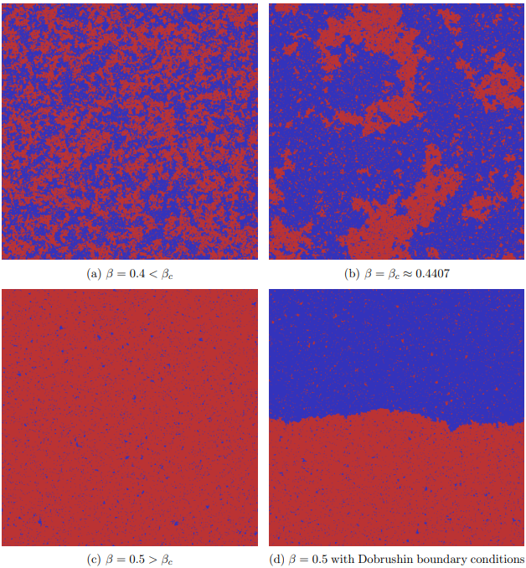
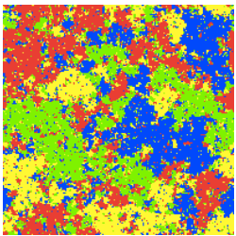
Phase transitions in pure systems I
Ising model: $S=\{−1,1\}$, $κ=\text{counting}$, $H\left(σ\right)=−\sum_{u\sim v}{σ_{u}σ_{v}}$.
The Ising model undergoes a phase transition in dimensions $d≥2$ as the temperature is lowered, from a disordered to an ordered state.
Similar behavior for the q-state Potts model ($S=\left\{1,2,…,q\right\}, H\left(σ\right)=−\sum_{u\sim v}{1_{σ_{u}=σ_{v}}}$).
d=2 Potts model with q=4 at criticality.
Simulation by Beffara.
Simulation from
Spinka–Peled 2019

Slide 4
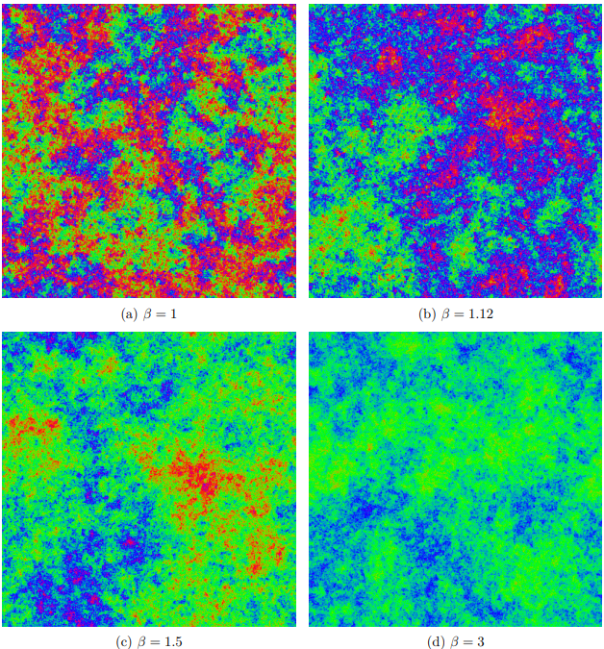
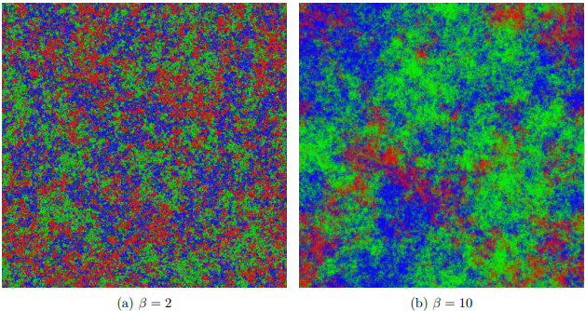
Phase transitions in pure systems II
Spin O(n) model with $n≥2$: $S=𝕊^{n−1}, κ=\text{uniform}, H\left(σ\right)=\sum_{u\sim v}{|σ_{u}−σ_{v}|^{2}}$
Mermin–Wagner theorem: The spin O(n) model does not exhibit an ordered phase in two dimensions (even at low temperature).
Fröhlich–Simon–Spencer theorem: A low-temperature ordered phase exists in dimensions $d≥3$.
In two dimensions: n=2 (XY model): Berezinskii–Kosterlitz–Thouless transition (proof by Fröhlich–Spencer) from exponential to power-law decay of correlations as temperature is lowered. n=3 (Heisenberg model): Polyakov conjecture – exponential decay at all temperatures.
Heisenberg model simulation
from Spinka–Peled 2019
XY model simulation from
Spinka–Peled 2019
Notes:
Fröhlich–Simon–Spencer is from 1976.

Slide 5
Disordered lattice systems
Noised observables: Let $f:S^{ℤ^{d}}→ℝ^{m}$, for some $m≥1$, be a bounded measurable function depending on the spins in a finite neighborhood of the origin. Disorder: Let ${\left(η_{v}\right)}_{v∈ℤ^{d}}$ be independent standard $m$-dimensional Gaussian vectors. Disordered Hamiltonian: $H^{η}\left(σ\right)=H\left(σ\right)−λ\sum_{v}{η_{v}⋅f\left(𝒯_{v}\left(σ\right)\right)}$ where $𝒯_{v}\left(σ\right)$ is the configuration $σ$ translated by $v$.
Examples: Random-field Ising model: $m=1$ and $f\left(σ\right)=σ_{0}$. Thus
$$H^{η}\left(σ\right)=−\sum_{u\sim v}{σ_{u}σ_{v}}−λ\sum_{v}{{η_{v}σ}_{v}}$$
Edwards-Anderson spin glasses: $S=\left\{−1,1\right\}, κ=\text{counting}$, $f\left(σ\right)={\left(σ_{e_{j}}σ_{0}\right)}_{j=1}^{d}$ .
$$H^{η}\left(σ\right)=−λ\sum_{u\sim v}{η_{u,v}σ_{u}σ_{v}}$$
Random-field $q$-state Potts model: $m=q$ and $f\left(σ\right)=\left(1_{σ_{0}=1},{…,1}_{σ_{0}=q}\right)$. Thus
$$H^{η}\left(σ\right)=−\sum_{u\sim v}{1_{σ_{u}=σ_{v}}}−λ\sum_{v}{\sum_{k=1}^{q}{{η_{v,k}1}_{σ_{v}=k}}}$$
Random-field spin $O(n)$ model, $n≥2$: $m=n$ and $f\left(σ\right)=σ_{0}$ (w$ith 𝕊^{n−1}⊂ℝ^{n}$), $H^{η}\left(σ\right)=\sum_{u\sim v}{|σ_{u}−σ_{v}|^{2}−λ\sum_{v}{{η_{v}⋅σ}_{v}}}$
Notes:
For the spin glass model the lambda parameter can be absorbed in the temperature.
Should we change the notation for the translation operator T_v since T is the temperature?

Slide 6
Imry-Ma phenomenon
Imry-Ma (1975) considered the effects of disorder for the random-field Ising and spin $O(n)$ models, and predicted that in low dimensions, an arbitrarily small disorder strength $λ$ causes the models to lose their ordered phase, as follows: The random-field Ising model is disordered at all temperatures for $d≤2$. The random-field spin $O(n)$ model is disordered at all temperatures for $d≤4$.
Aizenman-Wehr (1989) proved the predictions as part of a general statement.
Notation: Write $Λ_{L}≔{\left\{−L,…,L\right\}}^{d}$. For each disorder $η$, write ${〈⋅〉}_{μ}$ for the thermal expectation according to a Gibbs measure $μ$ of the $η$-disordered system. Write $ℙ$ and $𝔼$ for the probability and expectation operator over $η$.
Theorem (Aizenman-Wehr, special case): For a disordered lattice system with compact state space (as discussed above) in dimensions $d=1, 2$, at temperature $0≤T<∞$ and disorder strength $λ>0$, the limit
$$\lim_{L→∞}{\frac{1}{L^{d}}\sum_{v∈Λ_{L}^{d}}{{〈f\left(𝒯_{v}\left(σ\right)\right)〉}_{μ}}}$$
exists and has the same value for all Gibbs measures $μ$ and almost all $η$. The same holds in dimensions $1≤d≤4$ for the spin $O(n)$ models with $n≥2$.
Our goal: Develop a quantitative understanding of this phenomenon.
Notes:
One-dimensional case is clear so we focus on higher dimensions.
Both Imry-Ma and Aizenman-Wehr allow a much more general distribution of the disorder variables. Statement of Aizenman-Wehr is stronger: allows certain long-range interactions, almost surely is for all temperatures and non-random magnetic fields simultaneously and continuous-symmetry results allow more general rotationally-invariant distributions for the disorder variables and hold for a somewhat wider class of models.
Zero-temperature is explicitly allowed.
Explain theorem in examples: For the random-field Ising model the density of +1 is ½ (by symmetry) for all Gibbs states! For the random-field Potts models it shows that the density of each state is 1/q by symmetry. For spin glass models it shows that the density of satisfied edges is ½ by a gauge symmetry (flipping the spins on all the even sites and switching the sign of all eta’s at the same time makes satisfied edges becomes dissatisfied and vice versa).
For the spin O(n) models, the limit is zero by symmetry.
Analogous results for quantum spin systems were proved by Greenblatt-Aizenman-Lebowitz 2009.

Slide 7
Random-field Ising model
Random-field Ising model Hamiltonian: $H^{η}\left(σ\right)=−\sum_{u\sim v}{σ_{u}σ_{v}}−λ\sum_{v}{{η_{v}σ}_{v}}$
The disordered model still satisfies the usual monotonicity (FKG) properties. In particular, the model has maximal and minimal Gibbs measures $μ^{η,+}$ and $μ^{η,−}$, arising in the thermodynamic limit from constant boundary conditions. The Aizenman-Wehr theorem implies that $μ^{η,+}=μ^{η,−}$ in two dimensions $η$-almost surely, so that the model has a unique Gibbs measure.
A natural quantitative parameter is $m_{L}≔𝔼\left({〈σ_{0}〉}_{Λ_{L}}^{+}\right)$ where ${〈⋅〉}_{Λ_{L}}^{+}$ denotes the thermal expectation in ${\left\{−L,…,L\right\}}^{2}$ with $+1$ boundary conditions.
A bound of the form $m_{L}≤\exp\left(−c\left(λ,T\right)L\right)$ is relatively simple for large disorder strength $λ$ or high temperatures $T$, so interested in small $λ$ and low temperature.
Results: In dimension $d=2$: $m_{L}≤\frac{C\left(λ\right)}{\sqrt{\log{\log{L}}}}$ (Chatterjee 2017), $m_{L}≤\frac{C\left(λ\right)}{L^{c\left(λ\right)}}$ (Aizenman-P. 2018) and finally $m_{L}≤C\left(λ\right)\exp\left(−\frac{L}{ℓ(λ)}\right)$
proved at zero temperature by Ding-Xia 2019 and then at positive temperature by Ding-Xia 2019 and Aizenman-Harel-P. 2019.
Still open to determine correlation length $ℓ\left(λ\right)$ for small $λ$. Proof implies $ℓ\left(λ\right)≤e^{e^{1/λ^{2}}}$ (Bar-Nir 2022). Ding-Wirth (2020): Correlation length $=e^{Θ(λ^{−\frac{4}{3}})}$ in another sense.
Notes:
Mention that the model behaves like the model without disorder in dimensions d>=3, at low temperature and small disorder strength (Imbrie at T=0, Bricmont-Kupiainen at small T).
In any case correlation length is predicted to be quite large for small lambda (at low temperature).
Recall the Imry-Ma idea of proof?

Slide 8
Random-field Ising and Potts models
Dimension $d≥3$, weak disorder (small $λ)$: Imbrie 1985 (zero temperature) and Bricmont-Kupiainen 1988 (all temperatures) established long-range order in the random-field Ising model. A shorter argument was given recently by Ding-Zhuang (2021), also extending the result to the random-field Potts model.
Ding-Liu-Xia (2022), making use of Ding-Song-Sun (2023), extend the long-range order result to all temperatures lower than the critical temperature of non-disordered Ising model. Ding-Huang-Xia (2023) investigate the critical scaling for the disorder at the critical temperature of the non-disordered Ising model.
Rigas (2022) extended part of the correlation length result of Ding-Wirth to the random-field Potts model.
Notes:
Mention that the model behaves like the model without disorder in dimensions d>=3, at low temperature and small disorder strength (Imbrie at T=0, Bricmont-Kupiainen at small T).
In any case correlation length is predicted to be quite large for small lambda (at low temperature).
Recall the Imry-Ma idea of proof?

Slide 9
Quantitative results
The other models discussed (Potts, spin-glasses, spin $O(n)$) do not share the monotonicity properties of the random-field Ising model and the proof techniques break down for them. Indeed, even the choice of which quantity to bound is non-obvious since it is unclear which boundary conditions $τ$ maximize or minimize the average ${〈f\left(𝒯_{v}\left(σ\right)\right)〉}_{Λ_{L}^{2}}^{τ}$ and, indeed, it may be that these boundary conditions depend on the disorder $η$ and on $L$ and $v$. We obtain the following results.
Theorem (Dario-Harel-P 2020+): For each two-dimensional disordered lattice system of the type described above, at temperature $0≤T<∞$ and disorder strength $λ>0$, there exists $C>0$ so that for all $L≥2$,
$$𝔼\left(\sup_{τ_{1},τ_{2}:ℤ^{2}→S}\left\|\frac{1}{L^{2}}\sum_{v∈Λ_{L}^{2}}{{〈f\left(𝒯_{v}\left(σ\right)\right)〉}_{Λ_{L}^{2}}^{τ_{1}}}−{〈f\left(𝒯_{v}\left(σ\right)\right)〉}_{Λ_{L}^{2}}^{τ_{2}}\right\|\right)≤\frac{C}{{\left(\log{\log{L}}\right)}^{\frac{1}{4}}}$$
For the $d$-dimensional random-field spin $O(n)$ model with $n≥2$, at temperature $0≤T<∞$ and disorder strength $λ>0$, there exists $C>0$ so that for all $L≥2$,
$$𝔼\left(\sup_{τ:ℤ^{d}→S}\left\|\frac{1}{L^{d}}\sum_{v∈Λ_{L}^{d}}{{〈σ_{v}〉}_{Λ_{L}^{d}}^{τ}}\right\|\right)≤C\left\{\begin{matrix}L^{−\frac{1}{3}} & d=2 \\ L^{−\frac{1}{5}} & d=3 \\ {\left(\log{\log{L}}\right)}^{−\frac{1}{2}} & d=4\end{matrix}\right.$$
Notes:
Explain theorem in examples.
For the spin O(n) models a better exponent L^{-1} in two dimensions and L^{-1/2} in three dimensions is obtained for deterministic boundary conditions (when averaging over a box of half the volume).
The fluctuations in the general two-dimensional case is around a number which is independent of eta.

Slide 10
Uniqueness problem
Conjecture: For a disordered lattice system with compact state space (as discussed above) in dimension $d=2$, at temperature $0≤T<∞$ and disorder strength $λ>0$, it holds that $η$-almost surely, for all vertices $v∈ℤ^{2}$, the value of
$${〈f\left(𝒯_{v}\left(σ\right)\right)〉}_{μ}$$
is the same for all Gibbs measures $μ$ of the $η$-disordered system.
The conjecture is equivalent to the following finite-volume statement:
$$\lim_{L→∞}{\sup_{τ_{1},τ_{2}:ℤ^{2}→S}\left\|{〈f(σ)〉}_{Λ_{L}^{2}}^{τ_{1}}−{〈f\left(σ\right)〉}_{Λ_{L}^{2}}^{τ_{2}}\right\|}=0, η\text{−}\text{almost} \text{surely}$$
The value of $𝒯_{v}\left(σ\right)$ itself need not be unique in general systems. For instance, a global sign flip applied to $σ$ in a spin glass system (with Hamiltonian $H^{η}\left(σ\right)=−λ\sum_{u\sim v}{η_{u,v}σ_{u}σ_{v}}$) takes one Gibbs measure to another.
Applied to two-dimensional spin glasses at zero temperature, the conjecture implies the conjecture that the spin glass system has a unique ground-state pair.
Notes:
Weaker conjecture: In two dimensions, for $0≤T<∞$ and $λ>0$,
$$\lim_{L→∞}{\frac{1}{L^{d}}\sum_{v∈Λ_{L}^{d}}{||}}{〈f\left(𝒯_{v}\left(σ\right)\right)〉}_{μ_{1}}−{〈f\left(𝒯_{v}\left(σ\right)\right)〉}_{μ_{2}}||=0$$
for all pairs of Gibbs measures $μ_{1},μ_{2}$ of the $η$-disordered system, for almost all $η$.

Slide 11
Partial uniqueness result
Due to the disorder in the systems considered, it does not make sense to consider translation-invariant Gibbs measures. Instead, the following notion of translation-covariant Gibbs measures has been proposed.
A measurable map $ρ$ from the disorder variables $η$ to the Gibbs measures of the $η$-disordered system is called a translation-covariant Gibbs measure if
$$ρ\left(𝒯_{v}\left(η\right)\right)=𝒯_{v}\left(ρ\left(η\right)\right)$$
for all vertices $v∈ℤ^{d}$ (the translation $𝒯_{v}$ naturally extends to Gibbs measures).
Compactness arguments (Aizenman-Wehr, Newman-Stein) show that translation-covariant Gibbs measures always exist for the disordered systems considered above (as barycenters of translation-covariant metastates).
Theorem: For a disordered lattice system with compact state space (as discussed above) in dimension $d=2$, at temperature $0≤T<∞$ and disorder strength $λ>0$, it holds that $η$-almost surely, for all vertices $v∈ℤ^{2}$, the value of
$${〈f\left(𝒯_{v}\left(σ\right)\right)〉}_{ρ(η)}$$
is the same for all translation-covariant Gibbs measures $ρ$.
Corollary: For the two-dimensional spin glass model at zero temperature, if there exists a translation-covariant extremal Gibbs measure then there is a unique translation-covariant Gibbs measure up to a global sign flip.

Slide 12
Proof sketch for compact state space
Theorem recalled: For the above disordered systems with compact state space in two dimensions, at $0≤T<∞$ and $λ>0$, there exists $C>0$ so that for all $L≥2$,
$$𝔼\left(\sup_{τ_{1},τ_{2}:ℤ^{2}→S}\left\|\frac{1}{L^{2}}\sum_{v∈Λ_{L}^{2}}{{〈f\left(𝒯_{v}\left(σ\right)\right)〉}_{Λ_{L}^{2}}^{τ_{1}}}−{〈f\left(𝒯_{v}\left(σ\right)\right)〉}_{Λ_{L}^{2}}^{τ_{2}}\right\|\right)≤\frac{C}{{\left(\log{\log{L}}\right)}^{\frac{1}{4}}}$$
To simplify, assume $f\left(σ\right)=f\left(σ_{0}\right)∈ℝ$ and fix $T>0$. Write $Z_{T,Λ,τ}^{η}$ for the partition function at temperature $T$, in a finite $Λ⊂ℤ^{2}$ and with boundary conditions $τ$. Thus
$$Z_{T,Λ,τ}^{η}≔\int{e^{−\frac{1}{T}H_{Λ}^{η}\left(σ\right)}\prod_{v∈Λ}{dκ\left(σ_{v}\right)}\prod_{v∈Λ^{c}}{δ_{τ_{v}}\left(σ_{v}\right)}}$$
with $H_{Λ}^{η}\left(σ\right)$ the terms in the Hamiltonian $H^{η}\left(σ\right)=H\left(σ\right)−λ\sum_{v}{η_{v}f\left(𝒯_{v}\left(σ\right)\right)}$ depending on the spins in $Λ$. Let $F_{Λ}^{η}\left(τ\right)≔\frac{T}{\left|Λ\right|}\log{Z_{T,Λ,τ}^{η}}$ be minus the free energy.
Standard facts: 1) $F_{Λ}^{η}\left(τ\right)$ is a convex function of $η$.
2) For each $Λ$: $\sup_{τ_{1},τ_{2}}\left|F_{Λ}^{η}\left(τ_{1}\right)−F_{Λ}^{η}\left(τ_{2}\right)\right|≤\frac{C\left|∂Λ\right|}{\left|Λ\right|}$.
3) Write $η=({\hat{η}}_{Λ},η_{Λ}^{⊥})$ where ${\hat{η}}_{Λ}≔\frac{1}{\left|Λ\right|}\sum_{v∈Λ}{η_{v}}$ and $η_{Λ,v}^{⊥}≔η_{v}−{\hat{η}}_{Λ}$. Then
$$\frac{∂}{∂{\hat{η}}_{Λ}}F_{Λ}^{({\hat{η}}_{Λ},η_{Λ}^{⊥})}\left(τ\right)=\frac{λ}{\left|Λ\right|}\sum_{v}{{〈f\left(𝒯_{v}\left(σ\right)\right)〉}_{Λ}^{τ}},\text{with} \text{the} \text{sum} \text{over} \text{terms} \text{involving} \text{spins} \text{in} \text{Λ}$$
Notes:
The derivative is the “magnetization”. The sum in $\frac{∂}{∂\hat{η}}F_{Λ}^{η}\left(τ\right)$ is over terms involving the spins in $Λ$. Note that $\frac{∂}{∂\hat{η}}F_{Λ}^{η}\left(τ\right)$ is bounded uniformly in $Λ, η,τ$.

Slide 13
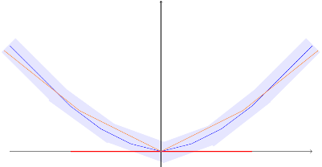
Proof sketch II
Lemma: Let $Λ$ satisfy $\left|∂Λ\right|≤C\sqrt{\left|Λ\right|}$. Then for each $δ>0$,
$$ℙ\left(\sup_{τ_{1},τ_{2}:ℤ^{d}→S}\left|\frac{λ}{\left|Λ\right|}\sum_{v}{f\left(𝒯_{v}\left(σ_{Λ,τ_{1}}^{η}\right)\right)−f\left(𝒯_{v}\left(σ_{Λ,τ_{2 }}^{η}\right)\right)}\right|<2δ\right)≥\exp\left(−\frac{Cλ^{2}}{δ^{4}}\right)$$
Proof sketch: Claim: Let g$:ℝ→ℝ$ be a convex 1-Lipschitz function. Set
$$N_{r}\left(g\right)≔\left\{h:ℝ→ℝ \text{convex}\text{ 1−}\text{Lipschitz} ∣ {\left\|h−g\right\|}_{∞}≤r\right\}.$$
Then for each $r,δ>0.$
$$\text{Leb}\left(\left\{x∈ℝ ∣ ∃h∈N_{r}\left(f\right), \left|h^{′}\left(x\right)−g^{′}\left(x\right)\right|≥δ\right\}\right)≤\frac{Cr}{δ^{2}}$$
Fix $τ_{0}:ℤ^{2}→S$ and let $g\left(x\right)≔F_{Λ}^{(x,η_{Λ}^{⊥})}\left(τ_{0}\right)$. Then for all $τ$, $F_{Λ}^{(⋅,η_{Λ}^{⊥})}\left(τ\right)∈N_{\frac{C\left|∂Λ\right|}{\left|Λ\right|}}\left(g\right)$. Thus, the Claim implies that
$$\text{Leb}\left(\left\{x∈ℝ ∣ ∃τ:ℤ^{2}→S, \left|\frac{∂}{∂{\hat{η}}_{Λ}}g_{Λ}^{(x,η_{Λ}^{⊥})}\left(τ\right)−\frac{∂}{∂{\hat{η}}_{Λ}}g_{Λ}^{(x,η_{Λ}^{⊥})}\left(τ_{0}\right)\right|≥δ\right\}\right)≤\frac{Cλ\left|∂Λ\right|}{\left|Λ\right|δ^{2}}≤\frac{Cλ}{\sqrt{\left|Λ\right|}δ^{2}}$$
Since ${\hat{η}}_{Λ}≔\frac{1}{\left|Λ\right|}\sum_{v∈Λ}{η_{v}}$ is Gaussian with standard deviation $\frac{1}{\sqrt{\left|Λ\right|}}$ we conclude that
$$ℙ\left(\sup_{τ:ℤ^{d}→S}\left|\frac{λ}{\left|Λ\right|}\sum_{v}{f\left(𝒯_{v}\left(σ_{Λ,τ}^{η}\right)\right)−f\left(𝒯_{v}\left(σ_{Λ,τ_{0}}^{η}\right)\right)}\right|<δ\right)≥\exp\left(−\frac{Cλ^{2}}{δ^{4}}\right)$$
which implies the lemma.
Notes:
Claim assumes differentiability of the functions (which is satisfied in the application) but otherwise a similar statement holds with the left and right derivatives at a point.
Claim is a quantitative version of the standard fact that if a sequence of convex functions converges pointwise to a convex function and x is a point of differentiability of the limit then the derivatives of the functions in the sequence converge to the derivative of the limiting function at x.

Slide 14
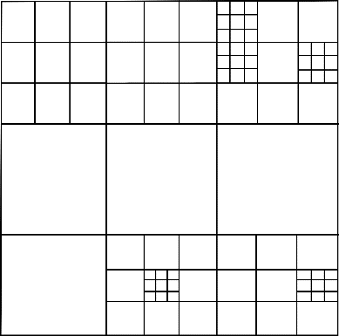
Proof sketch III
Let $L≥2$. Call a set $Λ^{′}⊂Λ_{L}$ $ε$-fluctuative if
$$\sup_{τ_{1},τ_{2}:ℤ^{d}→S}\left|\frac{λ}{\left|Λ′\right|}\sum_{v}{f\left(𝒯_{v}\left(σ_{Λ′,τ_{1}}^{η}\right)\right)−f\left(𝒯_{v}\left(σ_{Λ′,τ_{2 }}^{η}\right)\right)}\right|<ε$$
Perform a fractal percolation: Set $δ≔\frac{C\sqrt{λ}}{{\left(\log{\log{L}}\right)}^{\frac{1}{4}}}$ and $k=Cλ/δ$. Partition $Λ_{L}$ into $k$ squares. Then partition each of these into $k$ squares and so on until reaching squares of constant size. A square in this recursive partition is taken if it is $4δ$-fluctuative and the squares containing it are not $4δ$-fluctuative.
Define $B≔\{v∈Λ_{L}∣v \text{is} \text{not} \text{in} \text{a} \text{taken} \text{square}\}$. Then
$$\sup_{τ_{1},τ_{2}:ℤ^{d}→S}\left|\frac{λ}{\left|Λ_{L}\right|}\sum_{v}{f\left(𝒯_{v}\left(σ_{Λ_{L},τ_{1}}^{η}\right)\right)−f\left(𝒯_{v}\left(σ_{Λ_{L},τ_{2 }}^{η}\right)\right)}\right|≤4δ+\frac{C\left|B\right|}{\left|Λ_{L}\right|}$$
It remains to show that $ℙ\left(v∈B\right)≤δ$. Write $Λ_{0}\left(v\right)⊃Λ_{1}\left(v\right)⊃Λ_{2}\left(v\right)⊃…$ for the partition squares containing $v$. Since ${|Λ}_{ℓ+1}\left(v\right)\left|≤cδ\right|Λ_{ℓ}\left(v\right)|/λ$, one concludes that
$$\left\{v∈B\right\}⊂\bigcap_{ℓ}{\left\{Λ_{ℓ}\left(v\right)∖Λ_{ℓ+1}\left(v\right) \text{is} \text{not} 2δ\text{−}\text{fluctuative}\right\}}$$
The events in the intersection are independent since the annuli are disjoint. The previous lemma bounds their probabilities, concluding the proof.
Notes:
Consider introducing the notion of eps-fluctuative earlier. Maybe define instead the fluctuation (or oscillation, with the notation osc) of a set.

Slide 15
Non-compact case: Random-field random surfaces
We now discuss the effect of disorder on systems with non-compact state space. Our focus is on random surface models.
Let ${\left(η_{v}\right)}_{v∈ℤ^{d}}$ be independent standard Gaussian random variables.
A real-valued random-field random surface is the model on $φ:ℤ^{d}→ℝ$ with Hamiltonian
$$H^{η}\left(φ\right)=\sum_{u\sim v}{V\left(φ_{u}−φ_{v}\right)}−λ\sum_{v}{{η_{v}φ}_{v}}$$
where $V:ℝ→ℝ$ is a measurable even function termed the potential. The case $V\left(x\right)=x^{2}$ is the real-valued random-field Gaussian free field.
We also study the integer-valued random-field Gaussian free field which has the same Hamiltonian as above with $V\left(x\right)=x^{2}$ but restricts to $φ:ℤ^{d}→ℤ$.
Our goal the localization/delocalization properties of these disordered surfaces.
Without disorder: the gradient of these surfaces localizes in all dimensions $d≥1$. On $Λ_{L}^{d}$, real-valued surfaces delocalize with variance $L$ when $d=1$ and with variance $\log{L}$ when $d=2$ while staying localized for $d≥3$. The integer-valued GFF behaves similarly except for a roughening transition when $d=2$, from localized to logarithmic delocalization as the temperature increases.
Notes:
Real-valued case has apriori measure Lebesgue on R. Integer-valued case has apriori measure the counting measure on Z.

Slide 16
Random-field random surfaces: results
Theorem (Dario-Harel-P 2020+): Consider the real-valued random-field random surfaces above at all temperatures $0≤T<∞$ and all disorder strengths $λ>0$on $Λ_{L}^{d}$ with zero boundary conditions. Assume ${0<c}_{−}≤V^{′′}≤c_{+}<∞$. Then
Discrete Gradient: $𝔼\left(\left\langle \frac{1}{L^{d}}\sum_{\{u,v\}∈E\left(Λ_{L}^{d}\right)}{{\left(φ_{u}−φ_{v}\right)}^{2}}\right\rangle \right)≈\left\{\begin{matrix}L & d=1 \\ \log{L} & d=2 \\ 1 & d≥3\end{matrix}\right.$
Height fluctuations: $𝔼\left({\left\langle φ_{0}\right\rangle }^{2}\right)≈\left\{\begin{matrix}L^{4−d} & d=1,2,3 \\ \log{L} & d=4 \\ 1 & d≥5\end{matrix}\right.$
Theorem (Dario-Harel-P 2020+): The integer-valued random-field Gaussian free field, at all temperatures $0≤T<∞$ and disorder strengths $λ>0$, satisfies the gradient estimate above, and, when $d=1,2$, satisfies
$$𝔼\left(\left\langle \frac{1}{L^{d}}\sum_{v∈Λ_{L}^{d}}{φ_{v}^{2}}\right\rangle \right)≈L^{4−d}$$ Additionally, this expectation is bounded in $L$ in dimensions $d≥3$ at low temperatures and small disorder strength $λ>0$.
Notes:
\approx means up to positive constants depending only on d and V.
Mention membrane model connection somewhere?
Mention that Brascamp-Lieb inequality still applies in the real-valued case so that all fluctuations are due to the expectation field given eta. For the GFF this is the ground state but in general we don’t know the relation of the two.
The gradient in the integer-valued case delocalizes also in the critical dimension d=2, even at zero temperature.
No corresponding for the integer-valued random-field Gaussian free field in dimensions d>=3.

Slide 17
Random-field random surfaces: previous results
Bovier-Külske studied a random field Solid-On-Solid model in which the disorder enters differently from the way it is introduced here. They proved a certain form of delocalization in two dimensions (Bovier-Külske 1996) and localization in three and higher dimensions (Bovier-Külske 1994).
Külske and Orlandi 2006 prove that for all deterministic fields $η$, a random surface with field $η$ will delocalize with at least logarithmic variance in two dimensions, when the potential $V$ satisfies $\sup{V\left(x\right)<∞}$.
Van Enter and Külske 2008 proved a form of delocalization for the gradients of the random-field random surface for a wide class of potentials in two dimensions. The result is non-quantitative. They further proved a lower bound on the rate of correlation decay for gradient Gibbs measures, when they exist, in three dimensions.
Cotar and Külske proved the existence of translation-covariant gradient Gibbs measures for random-field random surfaces in dimensions $d≥3$ (Cotar and Külske 2012) and their uniqueness for each given expected tilt (Cotar and Külske 2015), for a large class of potentials.
Later results: Dario 2023 (thermodynamic limit), Sakagawa 2023 (maximum).

Slide 18
Open questions
For disordered systems with compact state space, improve the bounds on
$$𝔼\left(\sup_{τ_{1},τ_{2}:ℤ^{d}→S}\left\|\frac{1}{L^{d}}\sum_{v∈Λ_{L}^{d}}{{〈f\left(𝒯_{v}\left(σ\right)\right)〉}_{Λ_{L}^{d}}^{τ_{1}}}−{〈f\left(𝒯_{v}\left(σ\right)\right)〉}_{Λ_{L}^{d}}^{τ_{2}}\right\|\right)$$
If the sum is performed over a concentric box of half the size, does it decay exponentially fast with $L$ in two dimensions at all $T$ and $λ>0$?
Uniqueness conjecture: For two-dimensional disordered systems, for each $v∈ℤ^{2}$, $η$-almost surely, the value of ${〈f\left(𝒯_{v}\left(σ\right)\right)〉}_{μ}$ is the same for all Gibbs measures $μ$.
Is there a Berezinskii-Kosterlitz-Thouless type transition as the disorder strength lowers (i.e., transition from exponential to power-law decay) for the random-field spin $O(n)$ models with $n=2$ in dimensions $d=3$ or $d=4$? What about $n≥3$?
What is the localization/delocalization behavior of the integer-valued random-field Gaussian free field in dimensions $d≥3$ at high disorder strength $λ$? Conjecture: Delocalization in dimension $d=3$ and localization when $d≥5$. Thus we conjecture a roughening transition in the disorder strength for $d=3$.
Notes:
Interest is in low temperatures and all lambda.
Open questions: Better quantitative bounds for the compact state space cases. Is there a uniqueness Gibbs measure in two dimensions. Is there exponential decay of correlations there? Is there a Berezinskii-Kosterlitz-Thouless type transition as the disorder intensity lambda changes in the random-field spin O(n) model in dimensions d=3 or 4? (physics literature inconclusive on this)
Behavior of the integer-valued Gaussian free field in dimensions d>=3? Conjecture it localizes in dimensions d>=5. Does it delocalize in dimensions d=3,4? Is there a roughening transition in the disorder intensity in dimension d=4?
Is there a roughening transition as the temperature or disorder strength changes? The question bears some relationship with the random-phase sine-Gordon model.

Slide 19
Proof sketch for compact state space
Theorem recalled: For the above disordered systems with compact state space in two dimensions, at $0≤T<∞$ and $λ>0$, there exists $C>0$ so that for all $L≥2$,
$$𝔼\left(\sup_{τ_{1},τ_{2}:ℤ^{2}→S}\left\|\frac{1}{L^{2}}\sum_{v∈Λ_{L}^{2}}{{〈f\left(𝒯_{v}\left(σ\right)\right)〉}_{Λ_{L}^{2}}^{τ_{1}}}−{〈f\left(𝒯_{v}\left(σ\right)\right)〉}_{Λ_{L}^{2}}^{τ_{2}}\right\|\right)≤\frac{C}{{\left(\log{\log{L}}\right)}^{\frac{1}{4}}}$$
Simplification: Set $T=0$ and let the noised observable $f$ be scalar ($m=1$).
For given disorder $η$, finite domain $Λ⊂ℤ^{d}$ and boundary conditions $τ$ let
$$ε_{Λ}^{η}\left(τ\right)≔\sup_{σ:ℤ^{d}→S, σ≡τ \text{on} Λ^{c}}{−\frac{1}{\left|Λ\right|}H_{Λ}^{η}\left(σ\right)}$$
be minus the ground energy per volume, with $H_{Λ}^{η}\left(σ\right)$ the terms in $H^{η}\left(σ\right)=H\left(σ\right)−λ\sum_{v}{η_{v}f\left(𝒯_{v}\left(σ\right)\right)}$which depend on the spins in $Λ$.
Simple facts: 1) $ε_{Λ}^{η}\left(τ\right)$ is a convex function of $η$ (as supremum of linear functions).
2) For each $Λ$, with high $η$ probability: $\sup_{τ_{1},τ_{2}}\left|ε_{Λ_{L}}^{η}\left(τ_{1}\right)−ε_{Λ_{L}}^{η}\left(τ_{2}\right)\right|≤\frac{C\left|∂Λ\right|}{\left|Λ\right|}$.
3) Write $η=({\hat{η}}_{Λ},η_{Λ}^{⊥})$ where ${\hat{η}}_{Λ}≔\frac{1}{\left|Λ\right|}\sum_{v∈Λ}{η_{v}}$ and $η_{Λ,v}^{⊥}≔η_{v}−{\hat{η}}_{Λ}$. Then $\frac{∂}{∂{\hat{η}}_{Λ}}ε_{Λ}^{({\hat{η}}_{Λ},η_{Λ}^{⊥})}\left(τ\right)=\frac{λ}{\left|Λ\right|}\sum_{v}{f\left(𝒯_{v}\left(σ_{Λ,τ}^{η}\right)\right)}$ with $σ_{Λ,τ}^{η}$ the ground configuration.
Notes:
Consider writing everything already at positive temperature with free energy. Should we fix lambda=1 for notational simplicity?
At positive temperature, use free energy instead of ground energy.
What happens at those points where the ground state is not unique? We are glossing over the issue of the ground energy not being differentiable.
The derivative is the “magnetization of the ground state”. The sum in $\frac{∂}{∂\hat{η}}ε_{Λ}^{η}\left(τ\right)$ is over terms involving the spins in $Λ$. Note that $\frac{∂}{∂\hat{η}}ε_{Λ}^{η}\left(τ\right)$ is bounded uniformly in $Λ, η,τ$.

Slide 20
Idea of proof for compact state space
Theorem recalled (Dario-Harel-P 2020+): For each two-dimensional disordered lattice system of the type described above, at temperature $0≤T<∞$ and disorder intensity $λ>0$, there exists $C>0$ so that for all $L≥2$,
$𝔼\left(\left\|\sup_{ξ_{1},ξ_{2} \text{configurations}}\frac{1}{L^{d}}\sum_{v∈Λ_{L}}{{〈f\left(𝒯_{v}\left(σ\right)\right)〉}_{Λ_{L}}^{ξ_{1}}}−{〈f\left(𝒯_{v}\left(σ\right)\right)〉}_{Λ_{L}}^{ξ_{2}}\right\|\right)≤\frac{C}{{\log\left(\log\left(L\right)\right)}^{\frac{1}{4}}}$
Basic tool in proof: convexity of the free energy in the disorder variables.
For simplicity, focus on the case that the noised observable $f$ is scalar ($m=1$).
For fixed $η$, write $Z_{T,Λ,τ}^{η}$ for the partition function of the system at temperature $T$, in a finite domain $Λ⊂ℤ^{d}$ and with boundary conditions $τ$. Thus
$$Z_{T,Λ,τ}^{η}≔\int{e^{−\frac{1}{T}H_{Λ}^{η}\left(σ\right)}\prod_{v∈Λ}{dκ\left(σ_{v}\right)}\prod_{v∈Λ^{c}}{δ_{τ_{v}}\left(σ_{v}\right)}}$$
with $H_{Λ}^{η}\left(σ\right)$ the terms in the Hamiltonian $H^{η}\left(σ\right)=H\left(σ\right)−λ\sum_{v}{η_{v}f\left(𝒯_{v}\left(σ\right)\right)}$
which depend on the spins in $Λ$. Let ${\text{FE}}_{T,Λ,τ}^{η}≔−\frac{1}{T\left|Λ\right|}\log{Z_{T,Λ,τ}^{η}}$ be the free energy.
Standard facts: 1) ${\text{FE}}_{T,Λ,τ}^{η}$ is a convex Lipschitz function of $η$.
2) Write $\hat{η}≔\frac{1}{\left|Λ\right|}\sum_{v∈Λ}{η_{v}}$. Then $\frac{d}{d\hat{η}}{\text{FE}}_{T,Λ,τ}^{η}=\frac{λ}{\left|Λ\right|}\sum_{v∈Λ}{{〈f\left(𝒯_{v}\left(σ\right)\right)〉}_{T,Λ,τ}^{η}}$.
Notes:
Check the calculations

