Slide 1
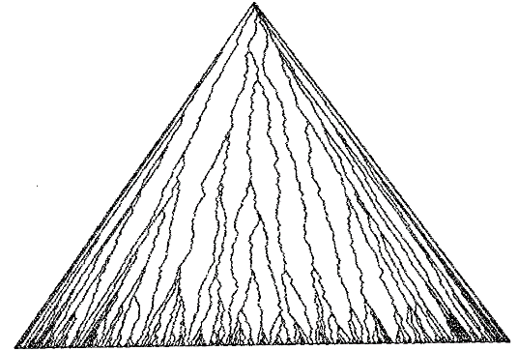
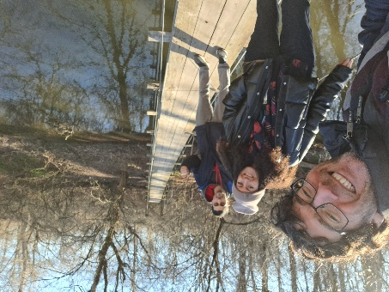
First-passage percolation on $ℤ^{d}$
© Kardar 1987
The authors find a fast route in the random environment
Ron Peled, Tel Aviv University and University of Maryland,
Based on joint work with Barbara Dembin and Dor Elboim
Seminar on Stochastic Processes, Indiana University, Bloomington Tutorial Lecture 2, March 19, 2025

Slide 2
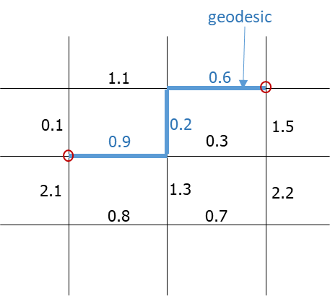
First-passage percolation
Idea: Random perturbation of an underlying geometry, formed by a random media with short-range correlations (Hammersley-Welsh 65). In this talk we focus on the discrete setting, working on the lattice $ℤ^{d}$ with $d≥2$.
Edge weights: Independent and identically distributed non-negative ${\left(τ_{e}\right)}_{e∈E\left(ℤ^{2}\right)}$. In this talk assume that their common distribution is absolutely continuous with a uniformly-positive density and has compact support in $(0,∞)$. E.g., $τ_{e}∼Uniform[1,2]$.
Passage time: A random metric $T_{u,v}$ on $ℤ^{d}$ given by
$$T_{u,v}≔\min_{}{\sum_{e∈p}{τ_{e}}}$$ with the minimum over paths $p$ connecting $u$ and $v$.
Geodesic: A path $p$ realizing $T_{u,v}$, denoted $γ_{u,v}$. Existence and uniqueness guaranteed by absolute continuity assumption.
Goal: Understand the large-scale properties of the metric $T$. In particular, understand long geodesics.
Notes:
Missing numbers on vertical edges!

Slide 3
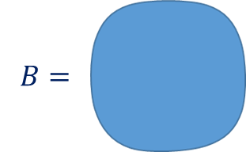
Basic predictions
For a point $v∈ℝ^{d}$ and $L>0$, consider the passage time $T_{0,Lv}$ and geodesic $γ_{0,Lv}$ (abbreviating $(0,0)$ to $0$ and rounding $Lv$ to the closest lattice point of $ℤ^{d}$).
Basic predictions: as $L→∞$, $𝔼$
the transversal fluctuations of $γ_{0,Lv}$ are of order $L^{ξ+o(1)}$. Scaling relation: $χ=2ξ−1$. In particular, $ξ≥\frac{1}{2}$. Open (even in physics literature!) whether $Std\left(T_{0,Lv}\right)→∞$ in all dimensions $d$.
For $d=2$, the model is in the KPZ universality class with $χ=\frac{1}{3}$ and $ξ=\frac{2}{3}$ (Huse-Henley 85, Kardar 85, Huse-Henley-D.S.Fisher 85, Kardar-Parisi-Zhang 86).
Limit norm: $μ(v)$ is a (deterministic) norm on $ℝ^{d}$, almost surely given by $μ\left(v\right)=\lim_{L→∞}{\frac{T_{0,Lv}}{L}}$
Limit shape: unit ball $B≔\left\{v∈ℝ^{d} :μ\left(v\right)≤1\right\}$ strictly convex. Specific shape of $B$ depends on the edge weight distribution. Unclear whether it is ever a Euclidean ball.
$$𝔼\left(T_{0,Lv}\right)=μ\left(v\right)L−c_{1}L^{χ+o(1)}\left(1+o\left(1\right)\right) \\ Std\left(T_{0,Lv}\right)=c_{2}L^{χ+o(1)}\left(1+o\left(1\right)\right)$$
Notes:
Shape is not quite symmetric here

Slide 4
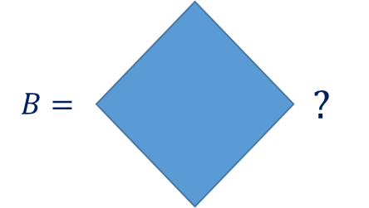
Rigorous results
Norm: $μ\left(v\right)$ is well defined. Not proved that its unit ball $B$ is strictly convex! Not even proved that $B$ is never the $ℓ_{1}$ or $ℓ_{∞}$ ball!
Standard deviation: $Std\left(T_{0,Lv}\right)≤c\sqrt{\frac{L}{\log{L}}}$ (Benjamini-Kalai-Schramm 03) $Std\left(T_{0,Lv}\right)≥c\sqrt{\log{L}}$ for $d=2$ (Pemantle-Peres 94, Newman-Piza 95) Transversal fluctuations: version of $ξ≥\frac{1}{d+1}$ (Licea-Newman-Piza 96) No proof that the transversal fluctuations are of order $o(L)$!
Scaling relation established conditionally (under assumptions which are presently unverified on the exponents and limit shape, Chatterjee 13, Auffinger-Damron 14).
Book of Auffinger-Damron-Hanson 15 surveys the rigorous state-of-the-art. Many basic questions remain open.
Detailed understanding available in two dimensions ($d=2$) for a related integrable model: Directed last-passage percolation (with specific edge weight distributions). However, no integrable first-passage percolation model is known.

Slide 5
Influence of edges and midpoint problem
Influence of edges: Recall that $T_{u,v}$ is the passage time between $u,v∈ℤ^{d}$. A natural notion of the influence of the weight $τ_{e}$ of an edge $e$ on $T_{u,v}$ is the probability that $e$ lies on the geodesic $γ_{u,v}$ between $u$ and $v$:
$$p_{e}≔p_{e}^{u,v}=ℙ\left(e∈γ_{u,v}\right)$$
It is clear that at least some of the edges near the endpoints $u,v$ must have large influence. Can there be any other edges with large influence? Versions of this problem go back at least to Kesten 86. The following is known as the Benjamini-Kalai-Schramm midpoint problem following their 02 paper: Prove $\lim_{\begin{aligned}|u−v|→∞ \\ u,v∈ℤ^{2}\end{aligned}}{ℙ\left(γ_{u,v} \text{passes} \text{within} \text{distance} 1 \text{of} \frac{u+v}{2}\right)}=0$
More generally, it is expected that: for any $ε>0$there is $r\left(ε\right)>0$ such that for each $v∈ℤ^{d}∖\{0\}$ and all edges $e$ with $dist\left(e,\left\{0,v\right\}\right)>r(ε)$ we have $p_{e}^{u,v}<ε.$
In two dimensions ($d=2$), this was proved in great generality by Ahlberg-Hoffman 16, following Damron-Hanson 15 who assumed the differentiability of the limit shape boundary. Both proofs are non-quantitative.
In all dimensions, Alexander 20 gets an optimal quantitative version under assumptions which are presently unverified on the exponents and limit shape.

Slide 6
Results (d=2: coalescence of geodesics and quantitative BKS midpoint problem)
Limit shape assumption: Next two results assume that the limit shape has more than 32 extreme points. We verify the assumption for a class of edge weight distributions (perturbations of a deterministic edge weight).
Theorem (Dembin-Elboim-P. 22, “Coalescence exponent $≥1/8$”): Let $d=2$. Let $u,v∈ℤ^{2}$ and set $L=|u−v|$. Then, for every $0<α<1/8$, $ℙ\left(∃z,w \text{with}\max\left\{|z−u|,|w−v|\right\}≤L^{α} \text{s}\text{.}\text{t}\text{. }\left|γ_{z,w}Δγ_{u,v}\right|>\frac{L}{\log{L}}\right)≤CL^{−c\left(α\right)}$
Presumably, the coalescence exponent equals $ξ=\frac{2}{3}$ in two dimensions.
Corollary (Dembin-Elboim-P. 22, quantitative BKS midpoint problem): Let $d=2$. Let $u,v∈ℤ^{2}$ and set $L=|u−v|$. Then, $ℙ\left(γ_{u,v} \text{passes} \text{within} \text{distance} 1 \text{of} \frac{u+v}{2}\right)≤CL^{−c}$
Highways and byways: Hammersley-Welsh 65 asked how many edges lie on infinite geodesics starting at the origin. For $d=2$, we prove a quantitative, power-law upper bound, following a non-quantitative result of Ahlberg-Hanson-Hoffman 22.
Notes:
Constants C,c are absolute. $c\left(α\right)$ depends only on $α$. Get 1/17 for exponent in BKS midpoint corollary.

Slide 7
Results (all $d$: number of influential edges)
Recall the influences $p_{e}=p_{e}^{u,v}=ℙ\left(e∈γ_{u,v}\right)$. Recall also that it is expected that all edges with $p_{e}>ε$ will be in an $r\left(ε\right)$ neighborhood of $u,v$. Our next theorem comes close to showing this by proving that the number of edges with $p_{e}>ε$ does not grow with the distance between $u$ and $v$.
Theorem (Dembin-Elboim-P. 23): Let $d≥2$. For each $ε>0$ there exists $C_{ε}$ such that for all $u,v∈ℤ^{d}$, $\left|\left\{e∈E\left(ℤ^{d}\right) :p_{e}^{u,v}≥ε\right\}\right|≤C_{ε}$
Moreover, we prove the following quantitative version, with $C>0$ universal,
$\left|\left\{e∈E\left(ℤ^{d}\right) :p_{e}^{u,v}≥ε\right\}\right|≤Cε^{−\frac{2d}{d−1}}\log{{\left(|u−v|\right)}^{\frac{d(d+1)}{d−1}}}$
The power of $ε$ is the one that would be expected from the bound $ξ≥\frac{1}{d+1}$. However, the version of this bound proved by Licea-Newman-Piza 96 is not strong enough to imply our result.
Our quantitative result addresses a problem raised by Benjamini-Kalai-Schramm 03 (it would have simplified their use of Talagrand’s inequality, allowing to bypass the “averaging trick”).
Notes:
The statement that is expected in the first paragraph is more general than the midpoint problem.

